Slide 1


Slide 2
description
The project is based on tours and travels to provide each and every person a good and excellent services across Pakistan with reasonable prices
The name of project is “Eden Toureister “
Its tagline is “Leading All-Ways”

Slide 3
MEMBERS
Raza Salahuddin (172041)
Hafsa Hussain (172050)
Laraib Shehzad (172069)

Slide 4
Problems
Travel agents
Hotel Reservations
Pricing Issues
Time Consumption
Few Facilities

Slide 5
Services
Monthly tours across Pakistan
Online Reservation of flights Tickets and Hotels
Providing the tourist market with the quality personnel required by tourism industry
Providing a high standard of services suitable for individuals seeking relaxing, comfortable and memorable experiences in the hospitality and tourism industry
You can get careem’s 25% off first 2 rides on booking from our site

Slide 6
Languages used
We have used.
HTML
CSS
JavaScript
PHP
SQL
Bootstrap

Slide 7
Html, CSS, JavaScript, bootstrap
These are the languages which are used to create GUI
It helps in Creating and sending data to the PHP files and responsive interface.
The website is completely responsive with each screen

Slide 8
Php and sql
PHP and SQL is used at the backend to store and retrieve data to websites database.
SQL basically is used to do CRUD in DB
PHP It is also used for _SESSIONS() and _COOKIES()

Slide 9
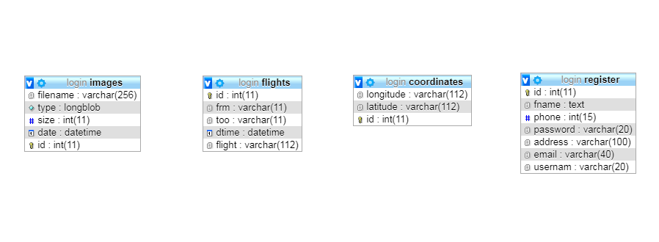
Tables used in Databases

Slide 10
Sessions() and Cookies()
_SESSIONS() are used to send the data of variables to other PHP file,
_COOKIES are used to tell the user about the following user is using this

Slide 11
Functionality
How website will work? Lets see.

